Slide 1
Accelerating Health Innovation in Pennsylvania
Governor Tom Wolf’s
Health Innovation in Pennsylvania Initiative
Lauren S. Hughes, MD, MPH, MSc, FAAFP
Deputy Secretary for Health Innovation
Pennsylvania Department of Health
Notes:
Good morning … Lauren Hughes … family physician + deputy secretary for health innovation.
Oversee Deputate for Health Innovation … not a real word! Only exists in Harrisburg. It’s an interesting experience to oversee something that isn’t real!
Responsible for coordinating five streams of work, and one where I have spent the most time is in innovation.
I look forward to sharing the work we have been doing over the past nine months to move forward one of the top priorities for the Governor.

Slide 2
US health expenditure is projected to make up >19% of GDP by 2019 (USD 4.5 trillion), growing from <16% in 2004
US national health expenditures USD trillion
X%
Percent of GDP
4.5
4.5
4.2
4.0
3.7
3.5
3.2
3.0
2.9
2.3
2.5
>19% of GDP in 2019, or ~$13K per resident
2.5
2.1
2.0
1.9
1.5
<16% of GDP in 2004
1.0
0.5
0
2004
06
08
10
12
14
16
18
2019
16%
16%
16%
17%
17%
17%
18%
19%
19%
Projected
SOURCE: Centers for Medicare & Medicaid Services, Office of the Actuary; OECD; Kaiser Family Foundation
Notes:
Cost conundrum is one reason why states are engaged in innovation --- unsustainable.
Concerns with:
Quality
Waste / duplication
Fragmented care
Poor overall health = PA has higher rates of infant mortality, heart disease, cancer, and depression compared to the US average.
Cost, quality, waste … these are the reasons to innovate from the health policy or system’s level perspective.

Slide 3
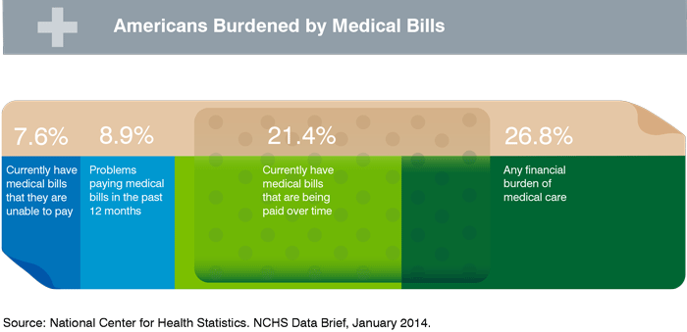
Significant consequences of medical expenses on families’ budgets
Notes:
But this slide is just as valid of a reason to be engaged in delivery system transformation as the former slide. This policy brief from the National Center for Health Statistics depicts the percentage of families burdened by medical expenses and those having difficulty paying bills. We know these families, and some of those families may have been us … where the burden of medical expenses upon families’ budgets has real consequences: whether or not families can afford other necessities, pursue leisure activities, or save for retirement.
The economics of health care and the impact this has upon families is another very real reason why states need to be engaged in this work.

Slide 4
States are innovating health and health care delivery across the US
States are innovating to:
Address the Triple Aim of better care, smarter spending, and healthier people …
Convene stakeholders through a Governor-led effort …
Set the direction and plan to implement multi-payer payment innovations and broader health delivery system transformation …
Implement at scale and statewide over the next 4 years.
DC
Puerto Rico
American Samoa
Comm. of Northern Mariana Islands
Notes:
4
4
4
ACA has ushered in significant change in the six years since its passage: formation of Marketplaces, Medicaid expansion, various insurance reforms.
As well, the ACA laid the groundwork for the creation of the CMS Innovation Center to test new ways of paying for, delivering, and coordinating health and health care.
SIM --- or the State Innovation Models Initiative --- is the largest program of all the models CMMI has developed:
1B of 10B
PA is one of 38 awards
Goals and description
PA received a design award in December 2014 to support the development of a comprehensive health and health care delivery system transformation plan. In my role, I have been overseeing this planning process for the past 9 months. We refer to the innovation work as the “Health Innovation in Pennsylvania” initiative. The DOH serves in a coordinating role for this work on behalf of our sister agencies.

Slide 5
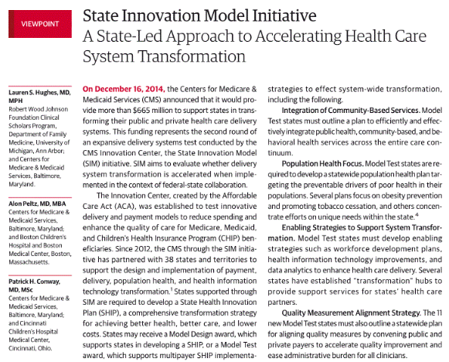
Why states are critical to health and health care delivery system reform
Notes:
Before I describe our planning process to date, I would like to highlight five key reasons that states are valuable to have engaged in innovation”
Payer of health care (Medicaid or Medical Assistance)
Purchase of health care (PEBTF)
Convener
Policy levers
Regulatory levers

Slide 6
Similarly to many states, HIP is a governor-sponsored state-led effort with broad stakeholder engagement
Details to follow
Governor's Policy Office (chair)
State-led effort
Broad stakeholder input
DOH
DHS
Steering committee
PID
DOA
OA
5 work groups
Health Innovation Center
5 state agencies help lead multi-stakeholder collaboration and overall plan development
Health Innovation Center supports development of approach, design principles, and preliminary strategy
Steering committee of health care leaders across PA provides feedback on content and direction
Work groups with diverse sets of expert leaders provide multi-stakeholder input for strategy design
1 Footnote
SOURCE: Source
Notes:
Who has been involved.
Stakeholders on the SC and across the 5 work groups include payers, providers, hospitals, population health experts, academic researchers, state officials, employers, consumers, foundations, associations, and community-based organizations.
Many thanks to Margaret who has been serving on our population health committee.

Slide 7
Major HIP planning milestones
July Stakeholder engagement kickoff with NGA
Nov
Webinar briefing for work group members
Work Groups Session 1: Input
Jan Steering Committee review
March
Work Groups Session 3: Refine
May Submit HIP plan to CMMI
Q3
Q4
Q1
Q2
Q3
2015
2016
Aug/Sept Begin work with PM firm
Early Jan
Work Groups Session 2: Test
End of Apr
Draft (outline) of full HIP plan complete
June In-person meeting with Steering Committee
Summer
Begin HIP plan implementation in phases
Notes:
What has our timeline been.

Slide 8
Objectives for Health Innovation in Pennsylvania (HIP)
In-going approach to accelerate innovation in PA
Primary strategies
Redesign rural health
Better care
Smarter spending
Healthier people
Outcome
Accelerate transition to paying for value
Achieve price and quality transparency
Supported by
Population health approaches
Health care transformation
HIT/HIE
Notes:
The three key priorities that have emerged during the planning process.

Slide 9
Priority #1 – Price and quality transparency end state vision and objectives
Performance transparency
“Shoppable” care transparency
Patients, providers, employers, and other stakeholders have clear understanding of cost and quality performance
Patients are empowered, enabled, and incented to make value-conscious decisions around their care choices
Rewarding value
Consumer behavior change
Level of transparency enables the implementation of innovative payment models to reward providers for delivering patient outcomes and cost-effectiveness
Consumers are able to understand the impact of their behaviors on their own personal health
Commonwealth plays different roles to achieve objectives:
Catalyzer of health care change for all
Actor, via actions that improve state-run programs

Slide 10
Priority #2 – Health care innovation will promote transition from volume- to value-based payment transformation
From
To
Payment model
Primarily fee-for-service payments rewarding volume over value
Value-based payment models promoting improved inpatient and outpatient hospital services
Site of care
Inpatient-centric reactive health care services
Outpatient-centric health care services with an emphasis on population health
Care delivery
Traditional care delivery without fully leveraging new technology improvements
Improved care delivery and care coordination enabled by technologies like remote care tele-health, video conferencing, remote monitoring, diagnostic scanning, and EHRs
Care quality
Little or no explicit focus on quality and safety through existing payment models
Direct incentives to improve quality and safety

Slide 11
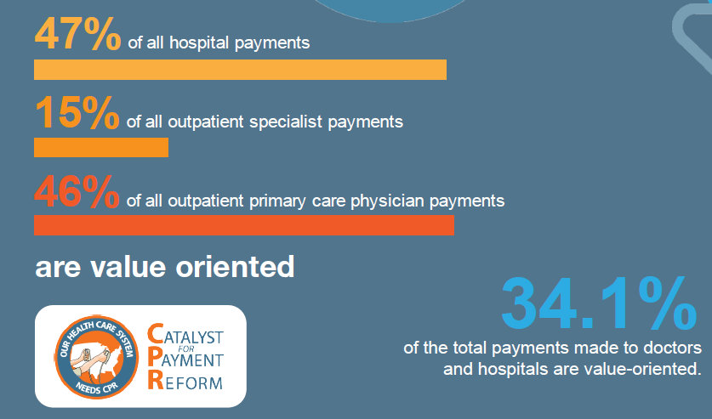
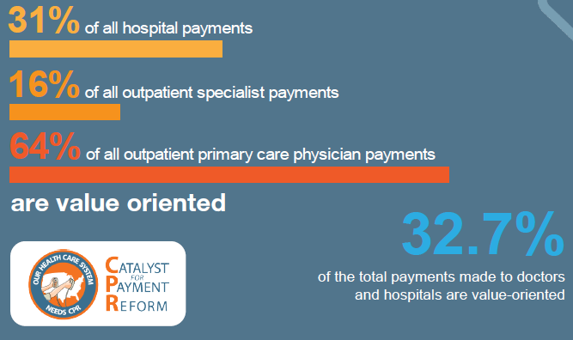
Establishing a baseline for Pennsylvania: Catalyst for Payment Reform
Commercial
Medicaid

Slide 12
Priority #3 – Health care delivery transformation for rural PA is an important focus of HIP
There are many opportunities to improve rural health care in Pennsylvania. Leveraging technology such as tele-health (consultation, remote monitoring, and patient wearables) will improve access to needed services.
Improving oral health and access to dental services are focus areas of the population health work group and technical assistance PA is receiving through the National Governors Association (NGA).
Exploring community health worker (CHW) roles, training, certification, and financing is also a focus of the NGA TA program and a 75-member stakeholder effort currently underway by the Jewish Healthcare Foundation to create and distribute a CHW strategic plan and toolkit.
Notes:
Lauren to discuss.

Slide 13
Drivers for achieving HIP objectives (1/2)
Primary Drivers
Secondary Drivers
Aims
By the end of 2019, Pennsylvania will,
Improve Population Health
Achieve or maintain top-quartile performance among states for adoption of best practices and outcomes in disease prevention and health improvement
Improve Health Care Quality and Care Experience
Achieve high standards for quality and consumer experience, including a reduction in avoidable hospital admissions and readmissions by 20%
Reduce Costs
Target a goal for the amount of care delivered in Pennsylvania utilizing payment models that promote and incent value-based care
Expanded Efforts:
Target women ages 18-44 for tobacco cessation
Promote the increase in physical activity in school day
Promote diabetes prevention and self-management
Promote oral health for children
Promote use of Prescription Drug Monitoring Program (PDMP) to track and monitor substance abuse
Population Health
Promote price and quality transparency through:
Explore creation of an all-payer claims database
Improve consumer health literacy
“Shoppable” care transparency for both commodities and episodes of care
Price & Quality Transparency
Establish a target for the commonwealth for the percent of care paid for under a value-based reimbursement structure through the use of:
Advanced Primary Care
Bundled Payments
Payment Reform

Slide 14
Drivers for achieving HIP objectives (2/2)
Primary Drivers
Aims
Secondary Drivers
By the end of 2019, Pennsylvania will,
Improve Population Health
Achieve or maintain top-quartile performance among states for adoption of best practices and outcomes in disease prevention and health improvement
Improve Health Care Quality and Care Experience
Achieve high standards for quality and consumer experience, including a reduction in avoidable hospital admissions and readmissions by 20%
Reduce Costs
Target a goal for the amount of care delivered in Pennsylvania utilizing payment models that promote and incent value-based care
Promote advancements in health information technology:
Support expansion of Health Information Exchange (HIE)
Support price and quality transparency efforts
Expand access through tele-health
Promote use of the PDMP
Develop a dashboard measuring population health outcomes
Health Information
Expand access to health care services (integrated primary care / behavioral health and oral health)
Re-convene Tele-health Advisory Committee
Explore workforce solutions in underserved areas, including community health workers and paramedicine
Enhance our health care workforce data collection capacity
Health Care Transformation

Slide 15
The Health Innovation in Pennsylvania plan: A transformation road map
PA will have a quantifiable plan for the next four years that will accelerate innovation resulting in better care, smarter spending, and healthier populations.
Notes:
Implementation: “how far, how fast we go …”
State as a driver versus convener
Collaborate with foundations, associations, other groups already leading on some of these strategies
Who will lead these efforts
Funding: combination of state resources / foundation support / P3
Long haul, multi-year perspective, ongoing and sustained stakeholder engagement.
The real work is about to begin.

Slide 16
To learn more, please visit the HIP website

Slide 17
Path forward to work together to support Health Innovation in Pennsylvania
The plan is just the beginning … and we look forward to working together to implement HIP!
If you have questions or are interested in getting involved in a particular area, please e-mail me at lauhughes@pa.gov.
Q&A
Notes:
17
How to get involved:
E-mail me.
Get engaged in a stakeholder group.
Let’s meet to further discuss the impact of reforms upon free and charitable clinics.

